Slide 1
Capstone Engagement
Assessment, Analysis, and Hardening of a Vulnerable System

Slide 2
Table of Contents
This document contains the following sections:
01
Network Topology
02
Red Team: Security Assessment
03
Blue Team: Log Analysis and Attack Characterization
Hardening: Proposed Alarms and Mitigation Strategies
04

Slide 3
Network Topology
3

Slide 4
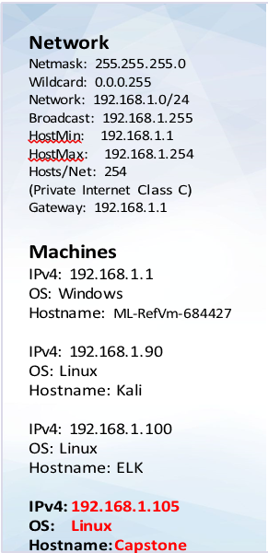
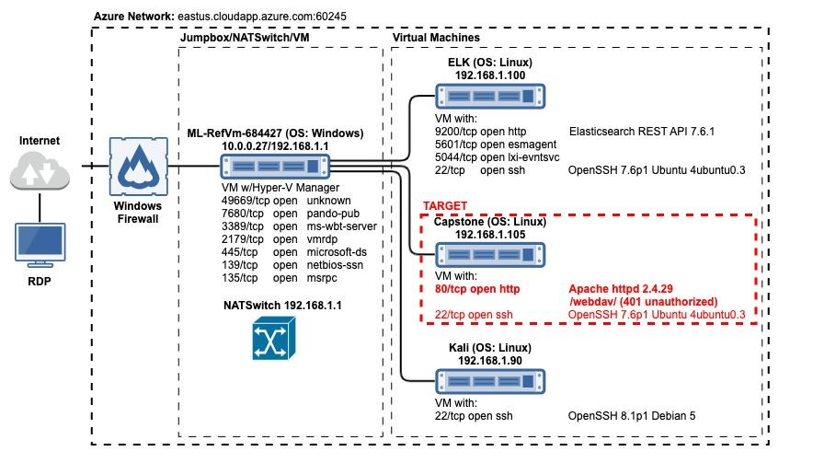
Network Topology

Slide 5

Red Team
Security Assessment
5

Slide 6
Recon: Describing the Target
Nmap identified the following hosts on the network:
Hostname | IP Address | Role on Network
Kali | 192.168.1.90 | Penetration testing system
Capstone | 192.168.1.105 | Web server
ELK | 192.168.1.100 | SIEM system
Ml-rEfVm-684427 | 192.168.1.1 | NATSwitch

Slide 7
Vulnerability Assessment
The assessment uncovered the following critical vulnerabilities in the target:
Vulnerability | Description | Impact
Directory listing enabled on apache web server | Able to use browser to read full contents of directories on capstone apache web server. | File revealed user ashton is the administrator for the directory: /company_folders/secret_folder/
Weak password & no failed password lockout | Weak password found in dictionary “rockyou”. No lockout for failed login attempts allowing brute force attack. | Brute force provided access to: /secret_folder/ Password hash for ryan Dev://192.168.1.105/webdav/
WebDav Vulnerability | The website contains information that ashton has control of the secret folder. | This gives a hacker the information that Ashton’s credentials will give access to the secret folder.
LFI Vulnerability | The website contains information that Ashton has control of the secret Folder. | This give a hacker the information that Ashton’s credential will give access to the secret folder.

Slide 8
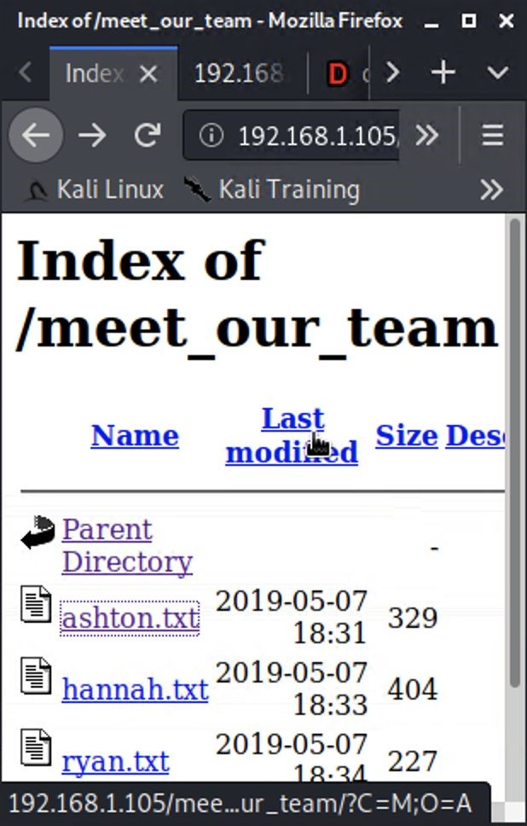
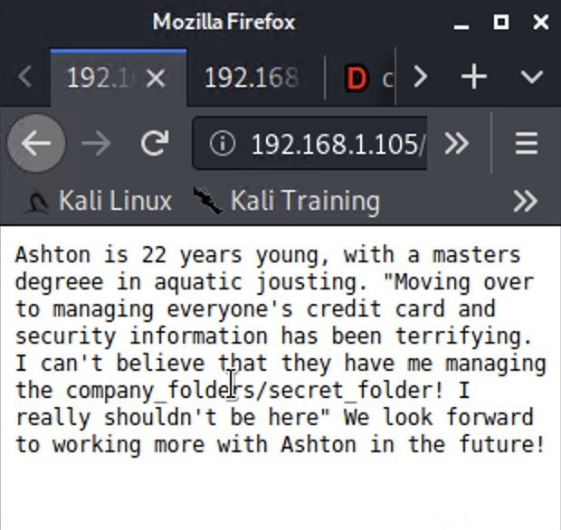
Exploitation: Directory Listing Enabled on Apache
01
02
03
01
02
03
Tools & Processes
Tools & Processes
Achievements
Results...
Running bash command to
Created a file containing all
get file list:
directories and file locations.
wget -r -np --spider
Reviewed files to determine
192.168.1.105/ 2>&1
| grep
further reconnaissance. E.g.
192.168.1.105
| grep -v -e
meet_our_team/ashton.txt
"Remote file" | uniq >
Found Ashton is the admin for
192.168.1.105
.txt
/company_folders/secret_folder/
Or
Navigating 192.168.1.105/
with any web browser

Slide 9

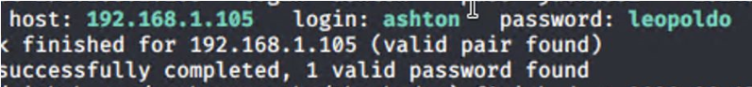
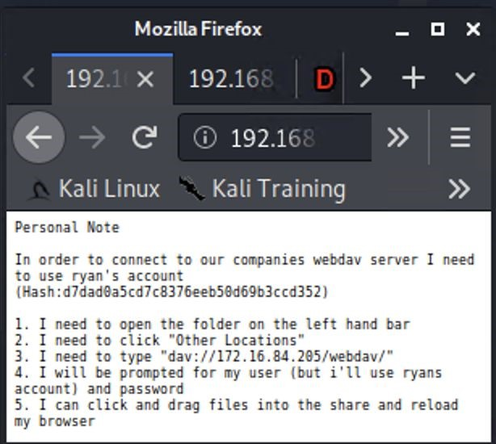
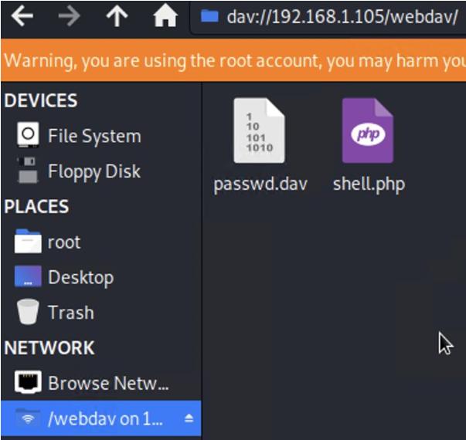
Exploitation: Weak Password & No Failed Password Lockout
02
03
02
03
Tools & Processes
Tools & Processes
Achievements
Executing Hydra brute force
found in ‘rockyou’ dictionary.
dictionary attack bash tool to
Password for Ashton was
get password for Ashton’s
account.
Access to the /secret_folder/
was achieved.
Access info for /webdav/
system was found.
Hash for Ryan’s password
was
found and cracked allowing
access to webdav.

Slide 10
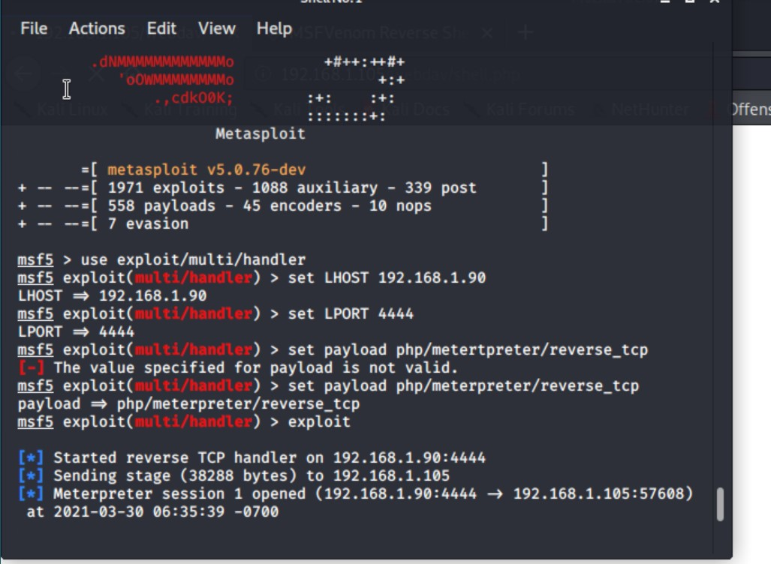
Exploitation: Open ports Vulnerability
01
02
03
Tools & Processes
I used port 4444 as my listening port and uploaded the payload to their webdav, simply by clicking on it in their directory their system opened a Meterpreter session for me.
Achievements
I was able to gain access to all the files on the remote server through Meterpreter.I opened a shell using terminal commands as their system is linux based.I browsed their system and found the flag I was looking for.

Slide 11

Blue Team
Log Analysis and Attack Characterization
11

Slide 12

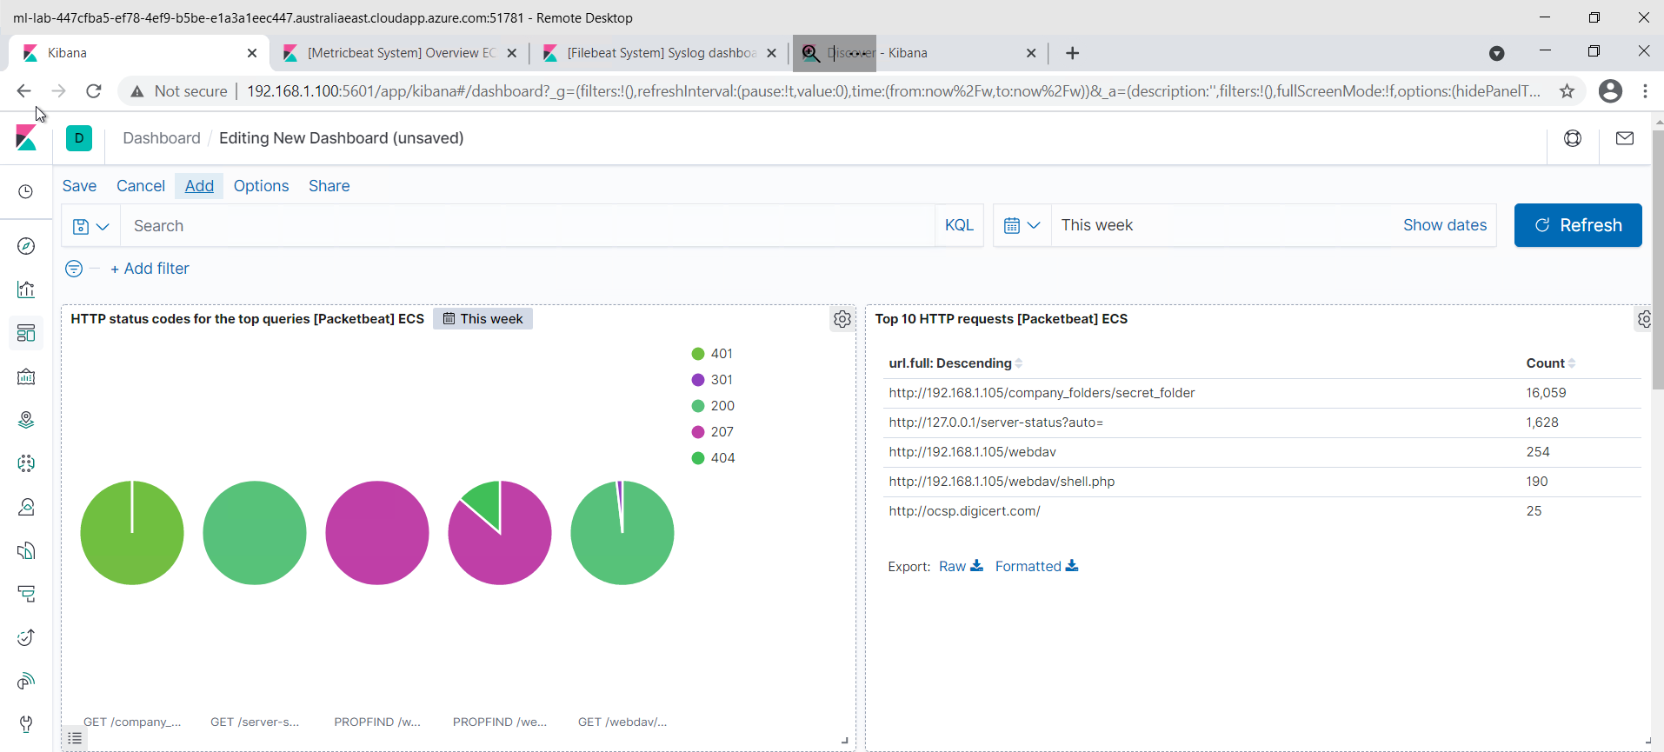
Analysis: Identifying the Port Scan
Answer the following questions in bullet points under the screenshot if space allows. Otherwise, add the answers to speaker notes.
What time did the port scan occur?
How many packets were sent, and from which IP?
What indicates that this was a port scan?
[Insert Here]
Include a screenshot of Kibana logs depicting the port scan.

Slide 13
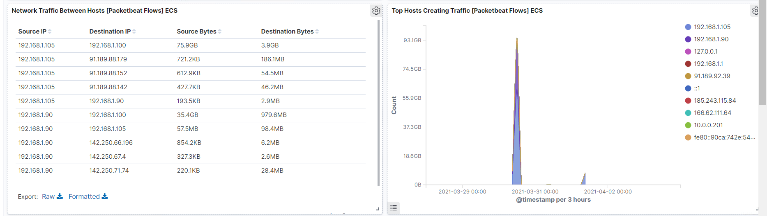
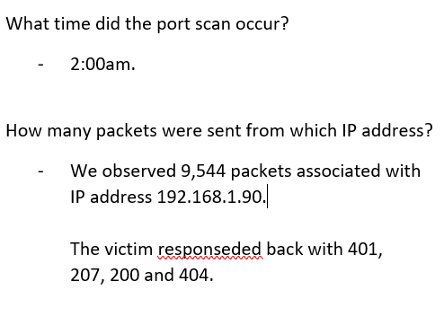
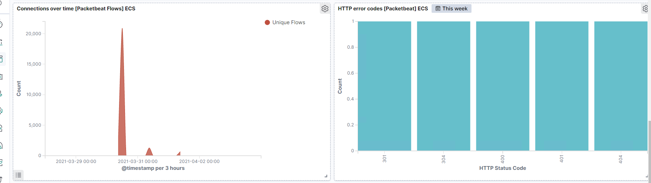
Analysis: Finding the Request for the Hidden Directory
Answer the following questions in bullet points under the screenshot if space allows. Otherwise, add the answers to speaker notes.
What time did the request occur? How many requests were made?
Which files were requested? What did they contain?
[Insert Here]
Include a screenshot of Kibana logs depicting the request for the hidden directory.

Slide 14
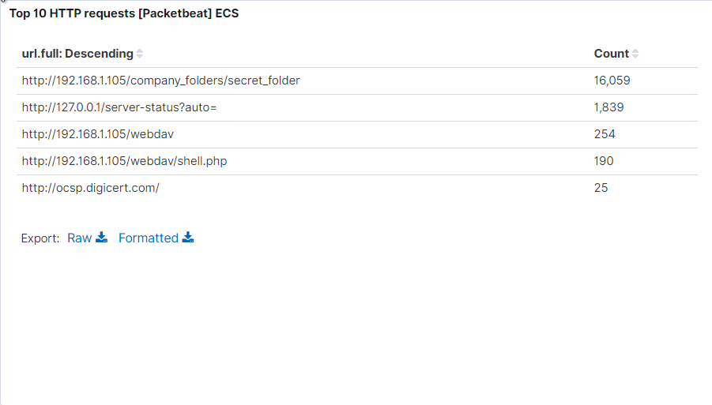
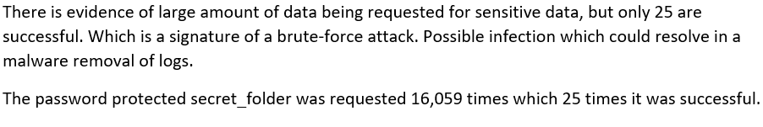
Analysis: Uncovering the Brute Force Attack
Answer the following questions in bullet points under the screenshot if space allows. Otherwise, add the answers to speaker notes.
How many requests were made in the attack?
How many requests had been made before the attacker discovered the password?
[Insert Here]
Include a screenshot of Kibana logs depicting the brute force attack.

Slide 15
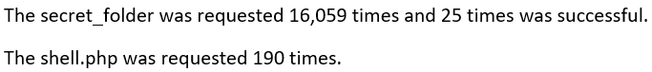
Analysis: Finding the WebDAV Connection
Answer the following questions in bullet points under the screenshot if space allows. Otherwise, add the answers to speaker notes.
How many requests were made to this directory?
Which files were requested?
[Insert Here]
Add a screenshot of Kibana logs depicting the WebDAV connection.

Slide 16
Blue Team
Proposed Alarms and Mitigation Strategies
16

Slide 17
Mitigation: Blocking the Port Scan
What kind of alarm can be set to detect future port scans?
Set up an alert for Port 22 and Port 80 traffic certain level of traffic in within a specific period.
What threshold would you set to activate this alarm?
- alarm fires when the level set for port 22 and 80 has a high level of traffic then normal.
What configurations can be set on the host to mitigate port scans?
-Disable Port 22 -Use white list access for Port 80 on the server to mitigate the vulnerability.

Slide 18
Mitigation: Finding the Request for the Hidden Directory
What kind of alarm can be set to detect future unauthorized access?
Only allow authorized IP addresses.
Have an alarm notify by email that an authorized IP is trying to gain access.
Whitelist with IP address.
What threshold would you set to activate this alarm?
- Have an alarm that fires when incoming IP address is detected that is not authorized.
What configuration can be set on the host to block unwanted access?
Encrypted file.
Restrict sensitive data to specific users only unless giving a decryption key by the users in charge.
Don’t save password and hash on the webdav server as party of policy.

Slide 19
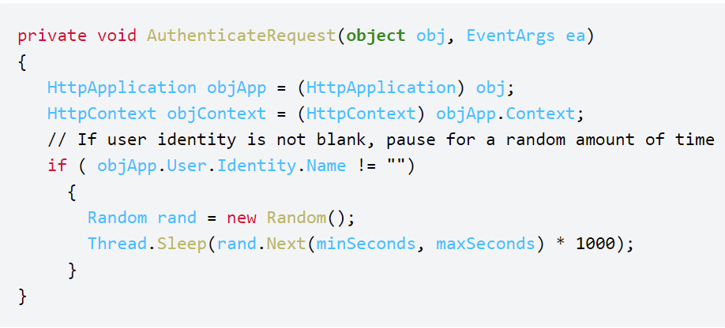
Mitigation: Preventing Brute Force Attacks
What kind of alarm can be set to detect future brute force attacks?
- Set Alert if encounter a threshold of login 10 failures from a specific email address within 1 minute.
What threshold would you set to activate this alarm?
- Stronger password policy, Password make up at least 10 character long with upper case letter, lower case letter, numbers and special characters.
What configuration can be set on the host to block brute force attacks?
Increase password length.
Increase password complexity.
Limit login attempts.
Implement captcha.
Use multi-factor authentication.
Describe the solution. If possible, provide the required command line(s).

Slide 20
Mitigation: Detecting the WebDAV Connection
What kind of alarm can be set to detect future access to this directory?
Trigger alarm when files are being added to the /webdav directory.
What threshold would you set to activate this alarm?
- Alarm fires when unauthorized IP addresses are trying to add files.
What configuration can be set on the host to control access?
Administrators should install and config filebeat on the host so it limits logins to a specified IP address or range.
Upload of file to /webdav directory is not permitted.
Set read only.

Slide 21
Mitigation: Identifying Reverse Shell Uploads
What kind of alarm can be set to detect future file uploads?
- Store uploaded files in a location not accessible from the web.
- Define valid types of files that the users should be allowed to upload.
What threshold would you set to activate this alarm?
- Set alarm to use port 443 (SSL), so network content cannot be inspected easily since it is encrypted.
What configuration can be set on the host to block file uploads?
- One effective technique to prevent php files from being executed is to place all codes in a supplementary files inside class definitions.

